Slide 1


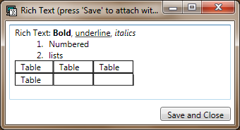
Available note types
Note text, oneliners
Screenshot button
Current note type
Transparency
Extended note button
Progress bar shows remaining time
Resize
Previous notes can be seen/reused by right-click
Context menu provides timer control and access to report files
Rich text extended note content is persistent, can be used over many notes

Slide 2

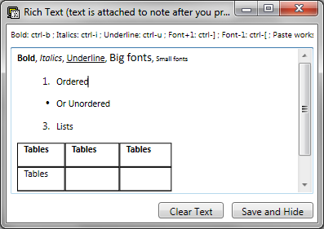
Note text, one-liners
Available note types
Note types.
(Use up/down arrow to change)
Screenshot button.
(use shift key to edit the shot)
Transparency
Extended note button
(use this for log pasting
error messages or
persistent information)
Resize
Progress bar shows remaining time
Charter is visible by hovering the mouse on notes area
Previous notes can be seen/reused by right-click
Context menu provides timer control and access to report files
Rich text extended note content is persistent, can be used over many notes

